Slide 1

Machine Learning
An Introduction

Slide 2
What is Artificial Intelligence, Machine Learning, and Deep Learning?

Slide 3
Artificial Intelligence
AI is the science of making things smart [1]
AI is can be defined as the ability of a machine to perform cognitive functions we associate with human minds, such as perceiving, reasoning, learning, interacting with the environment, problem solving, and even exercising creativity [2]
https://goo.gl/5Wd2vy
https://www.mckinsey.com/business-functions/mckinsey-analytics/our-insights/an-executives-guide-to-ai

Slide 4
AI: Common Applications
Object recognition
Speech recognition
Language Translation
Creative (e.g., Style Transfer – Learning to draw an image in the style of an artist
Prediction
Natural Language Processing
Recommendation System
Chat bot

Slide 5
Machine Learning
Machine Learning (ML) is a technique of learning from the data
ML is a sub-field of AI that allows machines to learn from the data without being explicitly programmed
ML allows users to input vast amounts of data into a computer algorithm, and then, lets the computer analyze the information to provide data-oriented predictions based only on the knowledge (rules) extracted from the data
The efficient prediction (fast and accurate) of ML algorithms is a reason why ML has become so successful in many fields today
Ref: eBook_Machine_Learning_bg_guide.pdf

Slide 6
ML: Learning
ML algorithms are designed in such a way that they can extract knowledge (rules) from any data. These rules are mappings (function) from input data to output data - questions to answers
Once the code is written for an ML application, the same code can then be re-used for future applications (e.g., the code written to recognize human faces can also be used to recognize animal faces provided we supply new data consisting of animal faces) - very powerful
ML algorithms can easily adapt to new data
After learning, ML algorithms can accurately predict answers to the new questions (unseen data) - accurate prediction

Slide 7
Deep Learning
Deep Learning is one of the key algorithms used in Machine Learning
DL was used in AlphaGo, a Go-playing program developed by Google that defeated the top human player in 2016
DL allows non-expert user to develop an expert level application
E.g., Merck activity prediction challenge in 2012, where a deep neural network not only won the competition and outperformed Merck’s internal baseline model, but did so without having a single chemist or biologist in their team
Ref: deep learning for computational chemistry.pdf

Slide 8
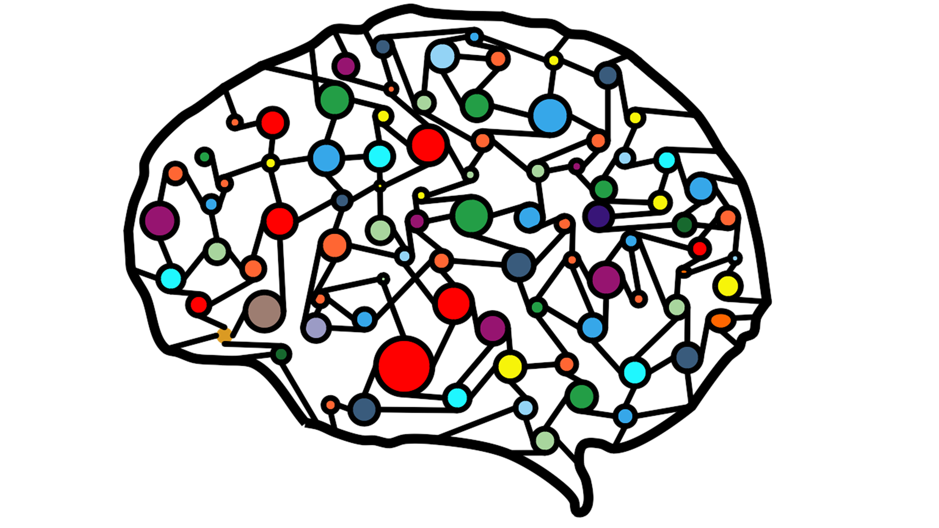
Deep Learning
Deep learning algorithms use networks inspired from the neurons in our brain
Deep learning powers many advanced applications today (e.g., face recognition, robotics, language translation etc.)

Slide 9
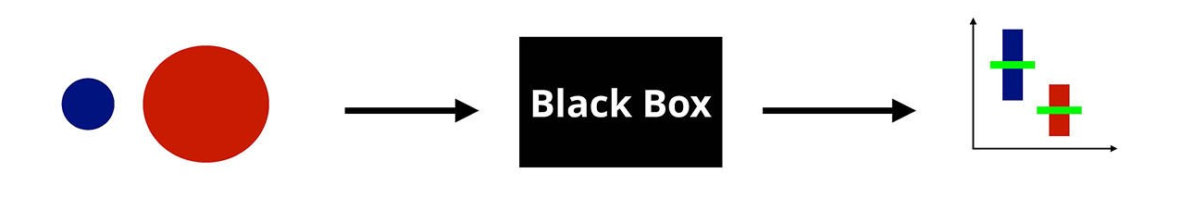
ML: Who can use?
Surprisingly, anyone can use ML today
You don't have to be an expert
Only familiarity with a programming language (e.g., python) is needed, you don’t have to be expert in coding
ML algorithms are already implemented (e.g., tensorflow, pytorch etc.)
All you need is a data, that's it!
Input Data
ML Algorithm
Output (predictions)

Slide 10

Summary
Ref: https://towardsdatascience.com/deep-learning-weekly-piece-the-differences-between-ai-ml-and-dl-b6a203b70698

Slide 11

Some Applications

Slide 12
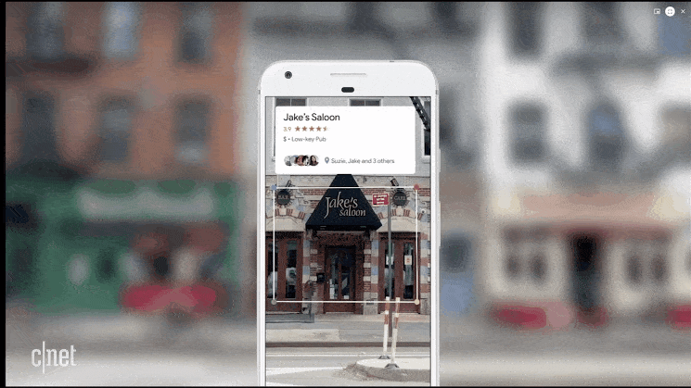
Google Lens
AI is a necessary part of Google’s search in order to provide the most suitable results. In combination with your GPS, it recognizes business that you’re passing in the street.
Ref: https://www.diyphotography.net/google-lens-will-turn-smartphones-camera-powerful-ai-ar-search-tool/

Slide 13
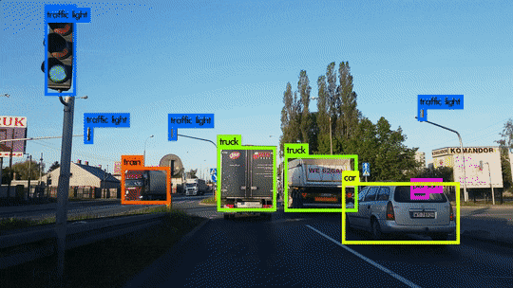
Self-Driving Car: Object Detection
Machine Learning is being used to detect objects such as cars, street sign
Ref: https://gfycat.com/gifs/tag/object+detection

Slide 14
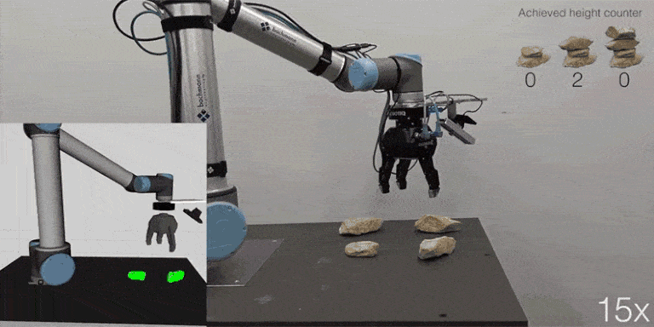
Robotic Arm Manipulation
Reinforcement Learning is an aspect of Machine learning where an agent learns to behave in an environment, by performing certain actions and observing the rewards/results which it gets from those actions
Ref: https://www.freecodecamp.org/news/a-brief-introduction-to-reinforcement-learning-7799af5840db/

Slide 15
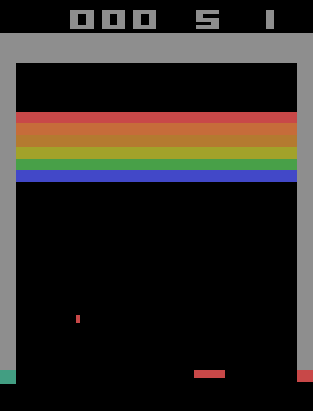
Playing Games
Another example of Reinforcement Learning in which an agent learns to play 'breakout' game better than human
Ref: https://towardsdatascience.com/tutorial-double-deep-q-learning-with-dueling-network-architectures-4c1b3fb7f756

